Slide 1
Diff eq ch 8

Slide 2
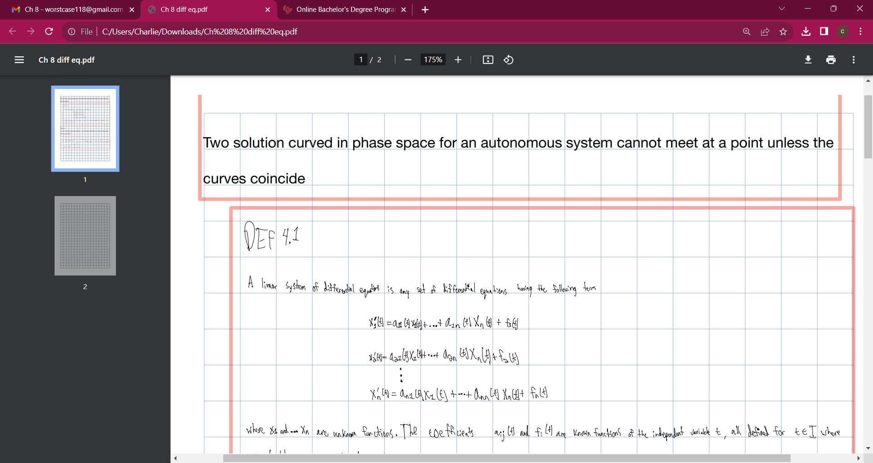

Slide 3
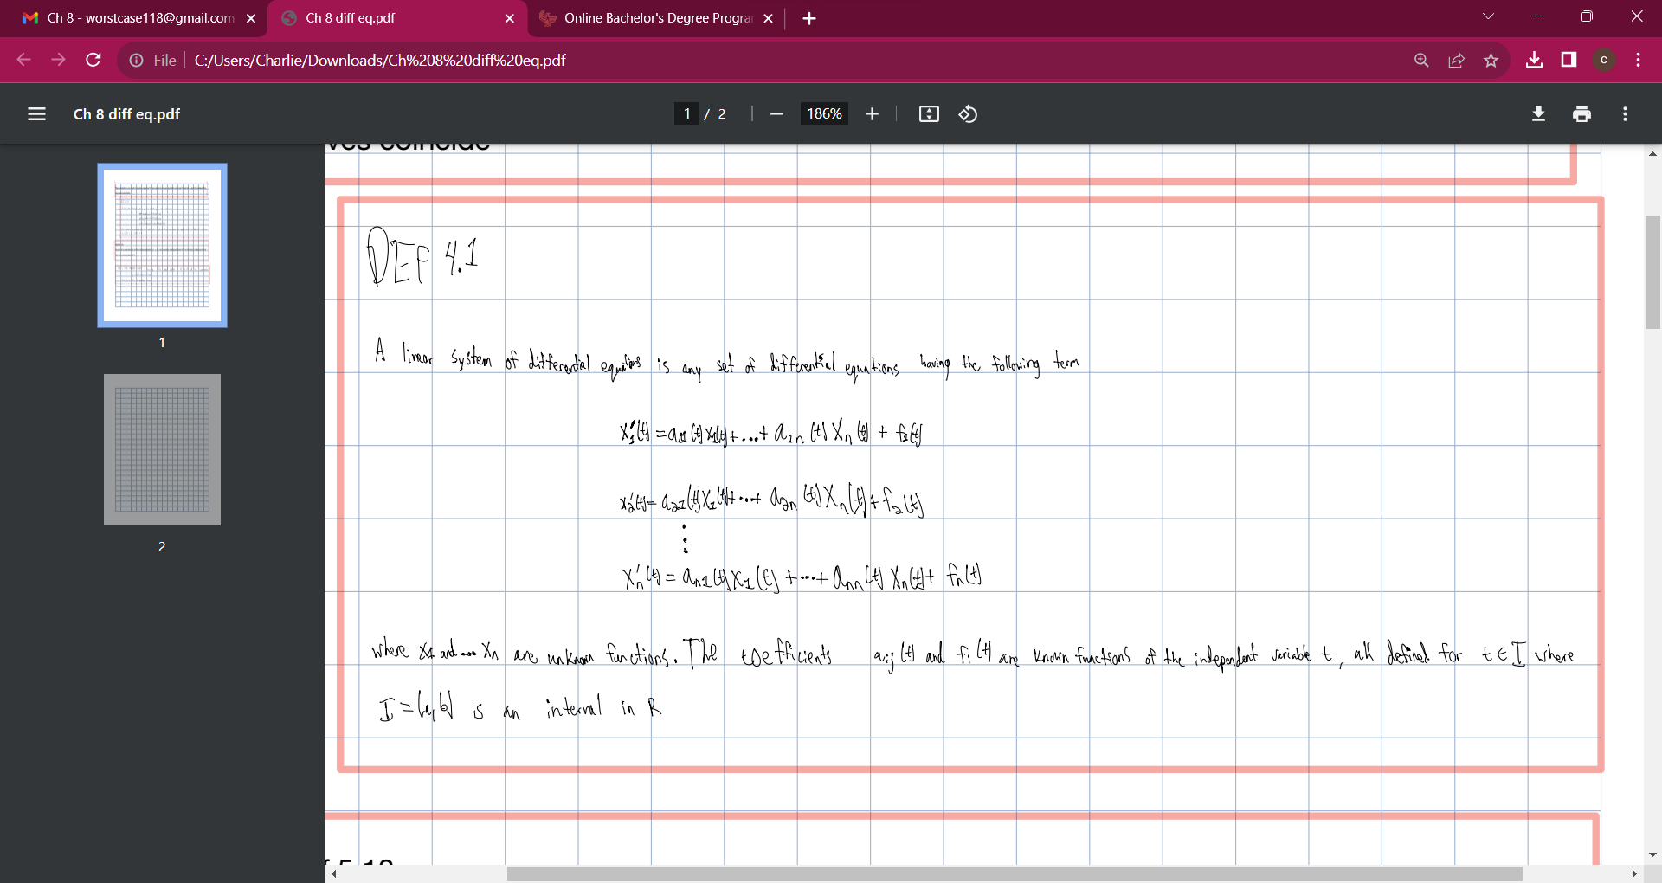

Slide 4
